Slide 1
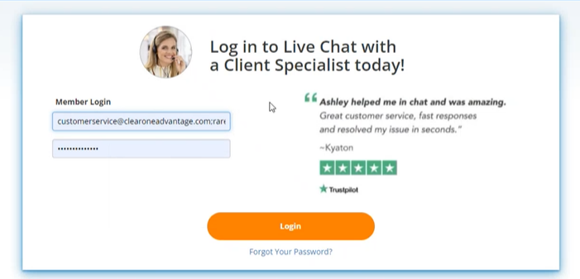
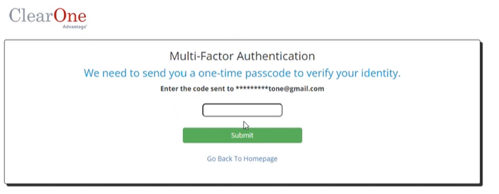

Multi Factor Authentication on Client Portal (Client Version)
12.14.23
To better protect our clients and their security, each time they log in they will be required to do a 2-part verification (password and authentication code)
Step 1: log into portal with user and password
Step 2: pop up for auth code

Slide 2
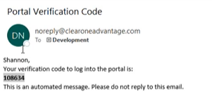
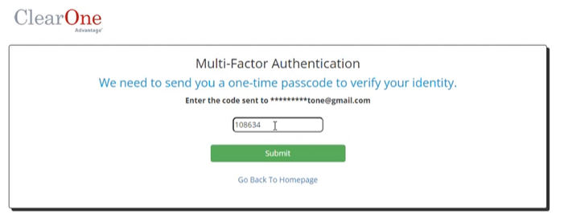
Multi Factor Authentication on Client Portal (Client Version cont)
12.14.23
Step 3: Review email for code
Step 4: Type in code and hit “submit”

Slide 3
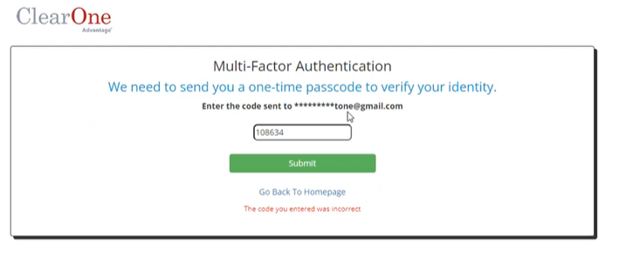
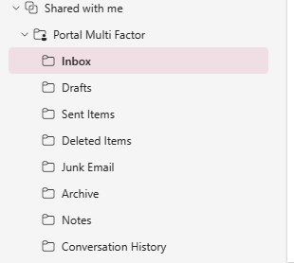
Multi Factor Authentication on Client Portal (Client Version cont)
12.14.23
If incorrect code is submitted client will get the following error but can try again with same code.
If COA Agent is trying to mirror client portal, the authentication code will be sent to the Shared Inbox called "Portal Multi Factor"

